Slide 1
GA CAPSTONE PROJECT:
Influence of Climate Change in the Media on iShares Global Clean Energy ETF Activity
- Building a Predictive Model -
Author: Theresa Waters
Course: General Assembly Data Science (Part-Time)
Date: Spring 2022

Slide 2
Agenda
Objectives
Data Extraction
Data Exploration
Modeling
Next Steps
Key Takeaways

Slide 3
Objectives
Question: Is a clean energy ETF’s volume influenced by media coverage of climate change related topics?
Use text from The New York Times Article Archive to gain insight into climate-change related topic trends over time
Incorporate article trends into a time series model of ICLN ETF volume data
Determine if climate change discussion in the media is a predictor for ICLN volume activity

Slide 4
Objectives
New York Times: Article Archive API
Alpha Vantage:
API
+
ARIMAX
Time Series Forecasting Model
Filter via Topic Modelling for Climate Change related articles from the last 10 years
Filter for iShares Global Energy Clean ETF (ICLN) daily results from the last 10 years
Climate Change: daily articles
(2012-2022)
ICLN:
daily volume
(2012-2022)

Slide 5
Agenda
Objectives
Data Extraction
Data Exploration
Data Modeling
Next Steps
Key Takeaways

Slide 6
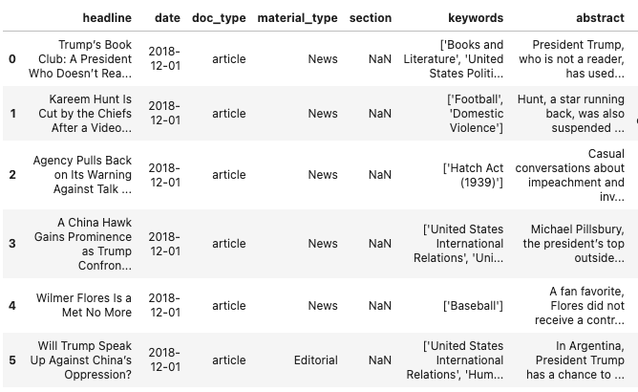
Data Extraction – The New York Times
Notes:
NYT API provides text data: headline, keywords, abstract

Slide 7
Agenda
Objectives
Data Extraction
Data Exploration
Modeling
Next Steps
Key Takeaways

Slide 8
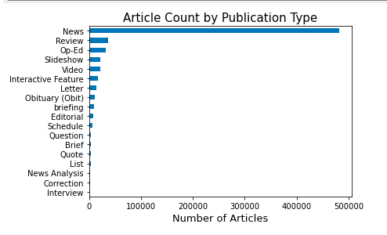
Data Visualization – The New York Times
Notes:
Most of the articles fall under News – this is the publication type I focused on

Slide 9
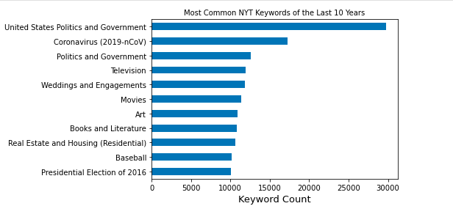
Data Visualization – The New York Times
Most Common Keywords in the News
Notes:
Top keywords in the news from the last 10 years do not relate to climate change

Slide 10
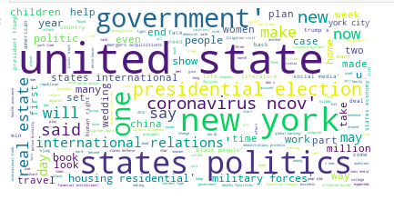
Data Visualization – The New York Times
Most Common Words Across All Article Text

Slide 11
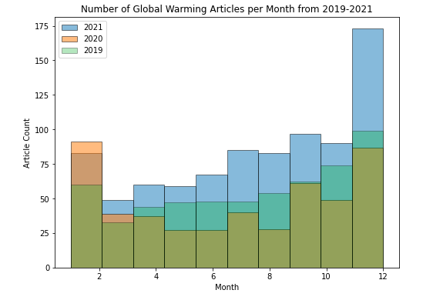
Data Visualization – The New York Times
Filtering for climate change related articles using only the keywords section: fall under ‘Global Warming’
Total GW articles from the last 10 years: 4,536

Slide 12
Agenda
Objectives
Data Extraction
Data Exploration
Modeling
Next Steps
Key Takeaways

Slide 13
Topic Model – New York Times
Is just using the ‘Global Warming’ keyword the best way to group articles related to topics important to climate change? E.g., Renewable energy, emissions, etc.
Non-Negative Matrix Factorization (NMF)
Unsupervised learning
Builds clusters of words (topics) from the text input
Organize articles by weight of topic
Headline
Abstract
Keywords

Slide 14
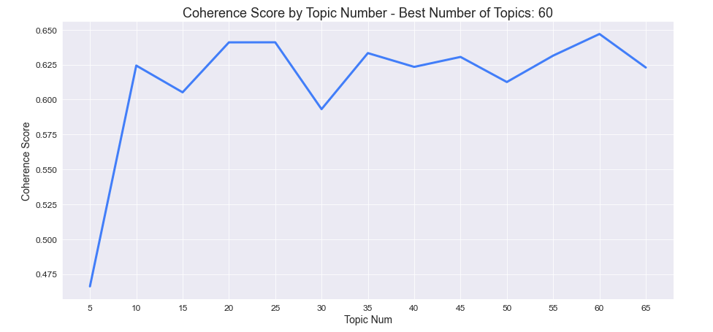
Topic Model – New York Times
Determining the best number of topics to input into model using coherence scores (how similar the words in each topic are to one another) – 60 topics

Slide 15
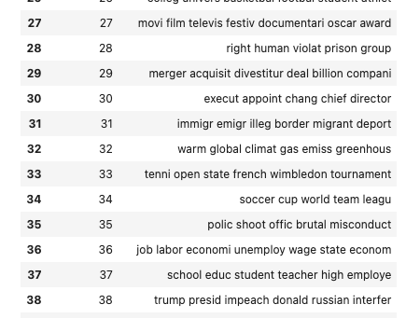
Topic Model – New York Times

Slide 16
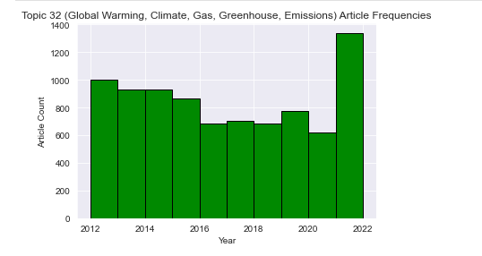
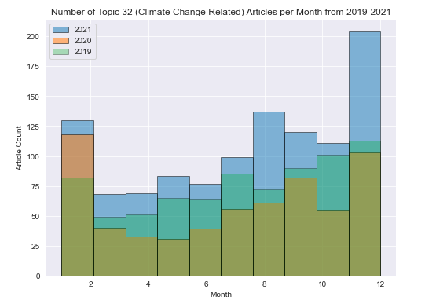
Topic Model – New York Times
Total number of articles: 8534

Slide 17
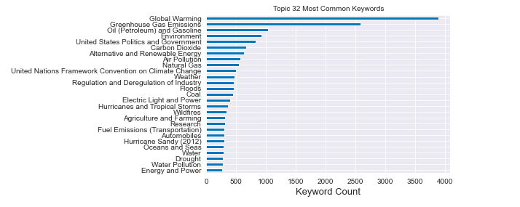
Topic Model – New York Times
Model is even more diverse than solely using the ‘Global Warming’ keyword as a filter

Slide 18
Agenda
Objectives
Data Extraction
Data Exploration
Modeling
Next Steps
Key Takeaways

Slide 19
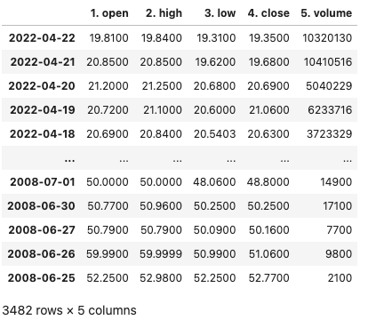
Data Extraction – Alpha Vantage API
Extracted data from 2012-2022 for the iShares Global Clean Energy ETF (ICLN)
Notes:
AV API gives numerical daily data for price and volume.

Slide 20
Agenda
Objectives
Data Extraction
Data Exploration
Modeling
Next Steps
Key Takeaways

Slide 21
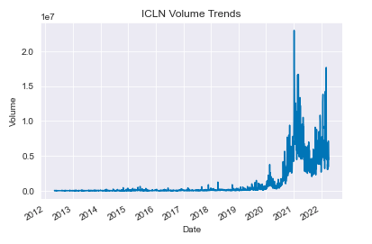
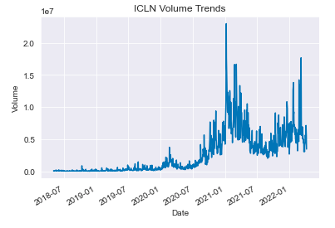
Data Exploration - ICLN
Most volume activity for the ICLN ETF has occurred in the last 4 years: filtered to use only 2018-2022 data for the time series model
Original: 2012-2022
New: 2018-2022

Slide 22
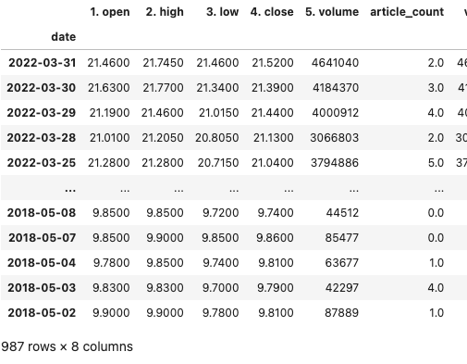
Merging NYT and ICLN Data

Slide 23
Agenda
Objectives
Data Extraction
Data Exploration
Modeling
Next Steps
Key Takeaways

Slide 24
Modeling – ARIMAX
Implemented a SARIMAX model (without seasonality ‘S’) to predict ICLN ETF volume activity
Incorporated climate change related NYT article counts into the model as an exogenous variable
ARIMAX
Time Series Forecasting Model

Slide 25
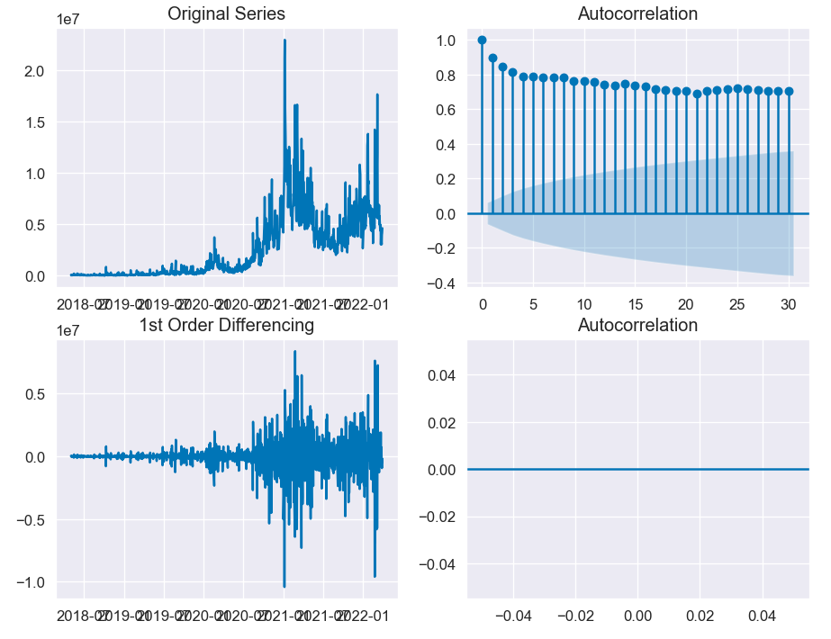
Modeling – ARIMAX
Determining parameters: Augmented Dickey Fuller (ADF) Test = p-value: 0.418176
Notes:
ADF p-value > 0.05
Volume data are non-stationary and need to be differenced

Slide 26
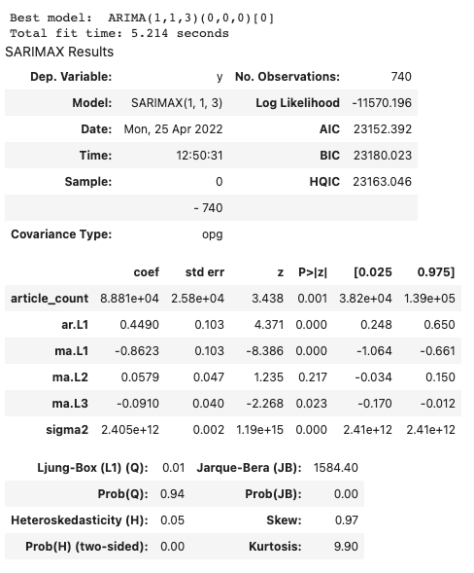
Modeling – ARIMAX
Notes:
Best fitting model (lowest AIC score)
Article count has significant impact on volume trends
Article count coefficient is positive – as article counts increase so does ICLN ETF volume

Slide 27
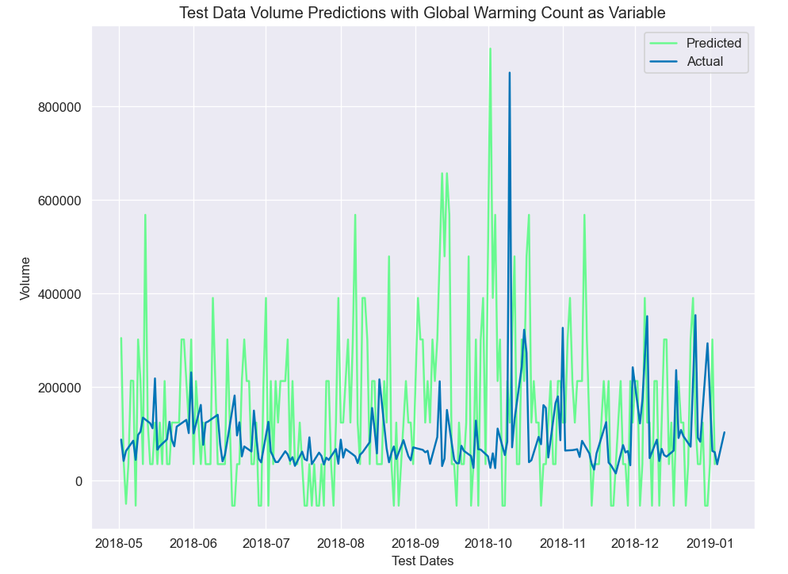
Modeling – ARIMAX
Split into training and test data for the model
Test predictions plotted against actual volume data
Notes:
Although the daily trends do not align perfectly, overall trends align

Slide 28
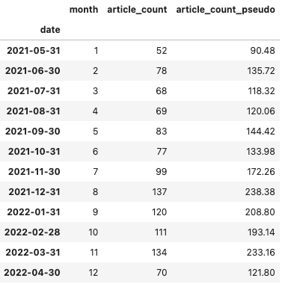
Modeling – ARIMAX - Forecast
Between 2020-2021 climate change related article counts increased by 74%
As climate change related events continue to become more prevalent could we see article counts increase by at least 74% from 2022-2023? What will this mean for the ICLN ETF?

Slide 29
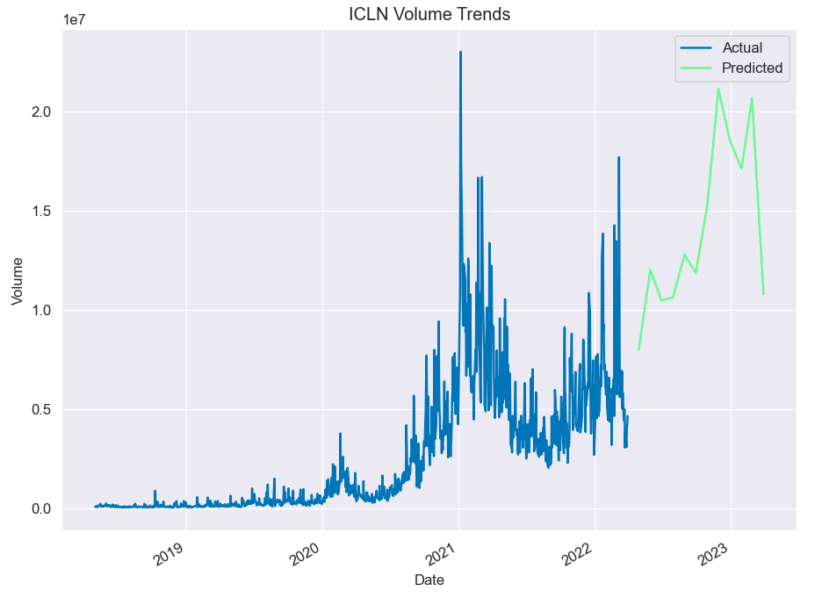
Modeling – ARIMAX - Forecast
Notes:
As article counts increase so will ICLN ETF volume!

Slide 30
Agenda
Objectives
Data Extraction
Data Exploration
Modeling
Next Steps
Key Takeaways

Slide 31
Next Steps
Is the noise of the daily volume data impacting the ARIMAX model?
Was first order differencing really the best parameter?
Incorporate more media sources into the model beyond The New York Times
Causality: does the model fit volume data for non-clean energy related ETFs? If not, then this is evidence the model is specific for ICLN and potentially other clean energy ETFs

Slide 32
Agenda
Objectives
Data Extraction
Data Exploration
Modeling
Next Steps
Key Takeaways

Slide 33
Key Takeaways
Topic modeling combined with Natural Language Processing is a successful tool for organizing large collection of texts
Time series forecasting provides evidence that the prevalence of climate change related news in the media has a positive influence on the activity of a clean energy ETF

Slide 34
Questions?

